Slide 1

Providing Farmers Full Credit for Conservation Practice Application in the Chesapeake Bay Watershed
Project Sponsors:
National Association of Conservation Districts in cooperation with USDA-NRCS
Notes:
Changes title slide.

Slide 2
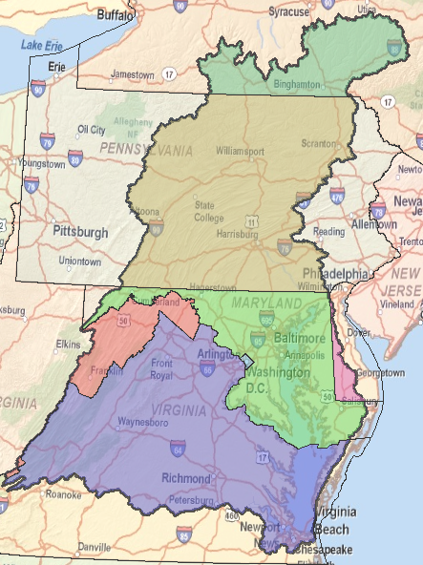
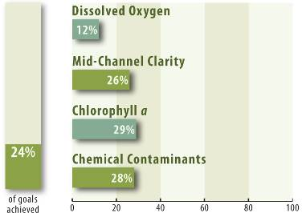
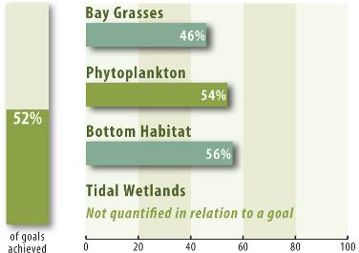
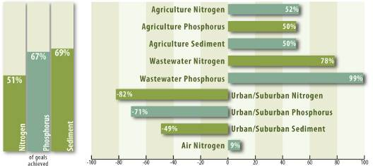
Water Quality
Bay Barometer
Habitats/Lower Food Web
Reducing Pollution
2
Notes:
The Chesapeake Bay Program (CBP) released the 2009 Bay Barometer last month, showing that the Bay continues to be degraded and illustrating a clear need to continue to accelerate restoration efforts across the region.
The science behind the Bay Barometer indicates that the Bay remains in poor condition, receiving an overall average health score of 45 percent, with 100 percent representing a fully restored ecosystem.

Slide 3
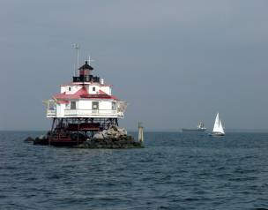
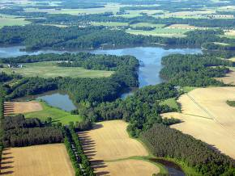
Presidential Executive Order
May 12, 2009:
President Obama issues
Executive Order 13508
on Chesapeake Bay
Restoration and Protection
Called the Chesapeake
Bay a “national treasure”
and ushered in new era of shared
federal leadership, action and
accountability
3

Slide 4
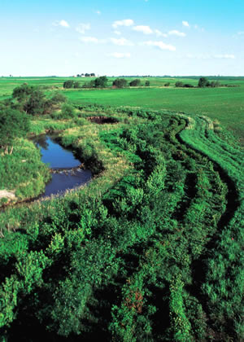
Chesapeake Bay Strategy
USDA 2011 Strategy
Key Goal: implement new conservation practices on 4 million acres of agricultural lands by 2025.
Key Actions:
Target CBWI funding to priority
watersheds and priority practices.
Lead an interdepartmental Environmental
Market Team to develop the standards
and protocols for environmental markets.
Work to improve the reporting system
for all conservation practices.
Establish Showcase watersheds to
demonstrate results in limited geographic
areas through increased outreach and technical assistance.
4
Notes:
Launching major initiatives & being accountable for progress: Strategy aims to protect the best and restore the rest. Initiatives include rigorous regulation to restore clean water, conservation practices on 4 million acres of farms, protection of 2 million acres of important lands and rebuilding of oyster populations in 20 tributaries. Accountability for progress will come through two-year milestones for action and measurable environmental goals.
Partnering with communities: Strategy is about improving the environment in communities throughout the entire 64,000-square-mile watershed and its thousands of streams, creeks and rivers. It is designed to support restoration efforts of local governments, groups and citizens; and provide economic benefits all around the Chesapeake region.
Deepening the federal commitment: Federal government is dedicating an unprecedented level of resources and actions, targeting resources where they can have the most impact, ensuring federal lands and facilities lead by example, and taking a comprehensive, ecosystem-wide approach to restoration.

Slide 5
Presidential Executive Order
Develop a system of accountability for tracking and reporting conservation practices:
  By July 2012, mechanisms for tracking and reporting of voluntary conservation practices and other best management practices installed on agricultural lands will be developed and implemented.
3
Notes:
Added this slide to emphasize the key commitment EPA and USDA made in E.O. Strategy specific to the tracking and verification of non-cost shared practices.

Slide 6


Conservation Practice Implementation - Desired Outcome
To have a full accounting of all conservation practice implementation on Agricultural Lands in the Chesapeake Bay States.
Desired Goals:
  Develop a sustainable cost effective record system for all conservation practices in the 6 Bay States.
  Reduce differences between state input to EPA.
  Reduce Agricultural Land Practice TMDL Implementation Requirements.
  To provide data that will assist in a more accurate estimate of future conservation needs on Agricultural Lands.
  To effectively direct scarce resources to solutions that get the most cost effective results for water quality while promoting agricultural production sustainability.

Slide 7
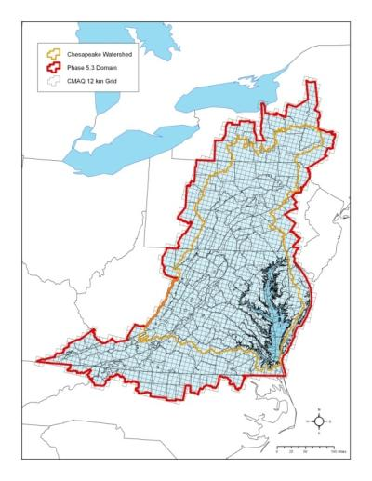
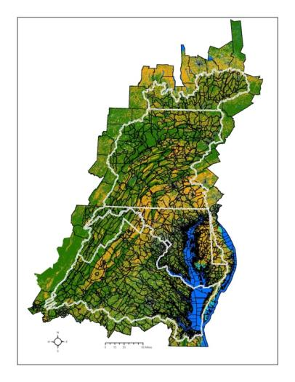
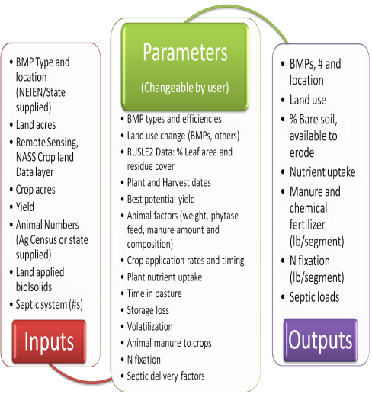
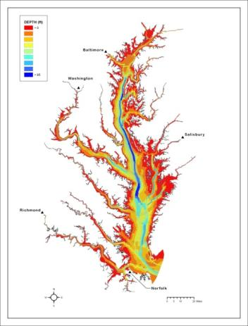
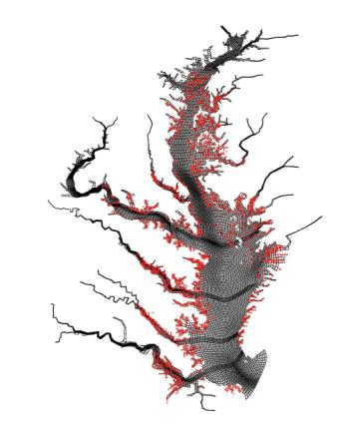
Chesapeake Bay Airshed Model
Chesapeake Bay Land Change Model
Chesapeake Bay Scenario Builder
Chesapeake Bay Watershed Model
Chesapeake Bay Water Quality and Sediment Transport Model
Chesapeake Bay Filter Feeder Model
Notes:
Inserted this slide of the suite of six partnership models and tools. Main point, it’s not just about the CB Watershed Model, it’s a suite of models that are linked together to describe nutrient and sediment inputs to the watershed, transport, and water quality.

Slide 8

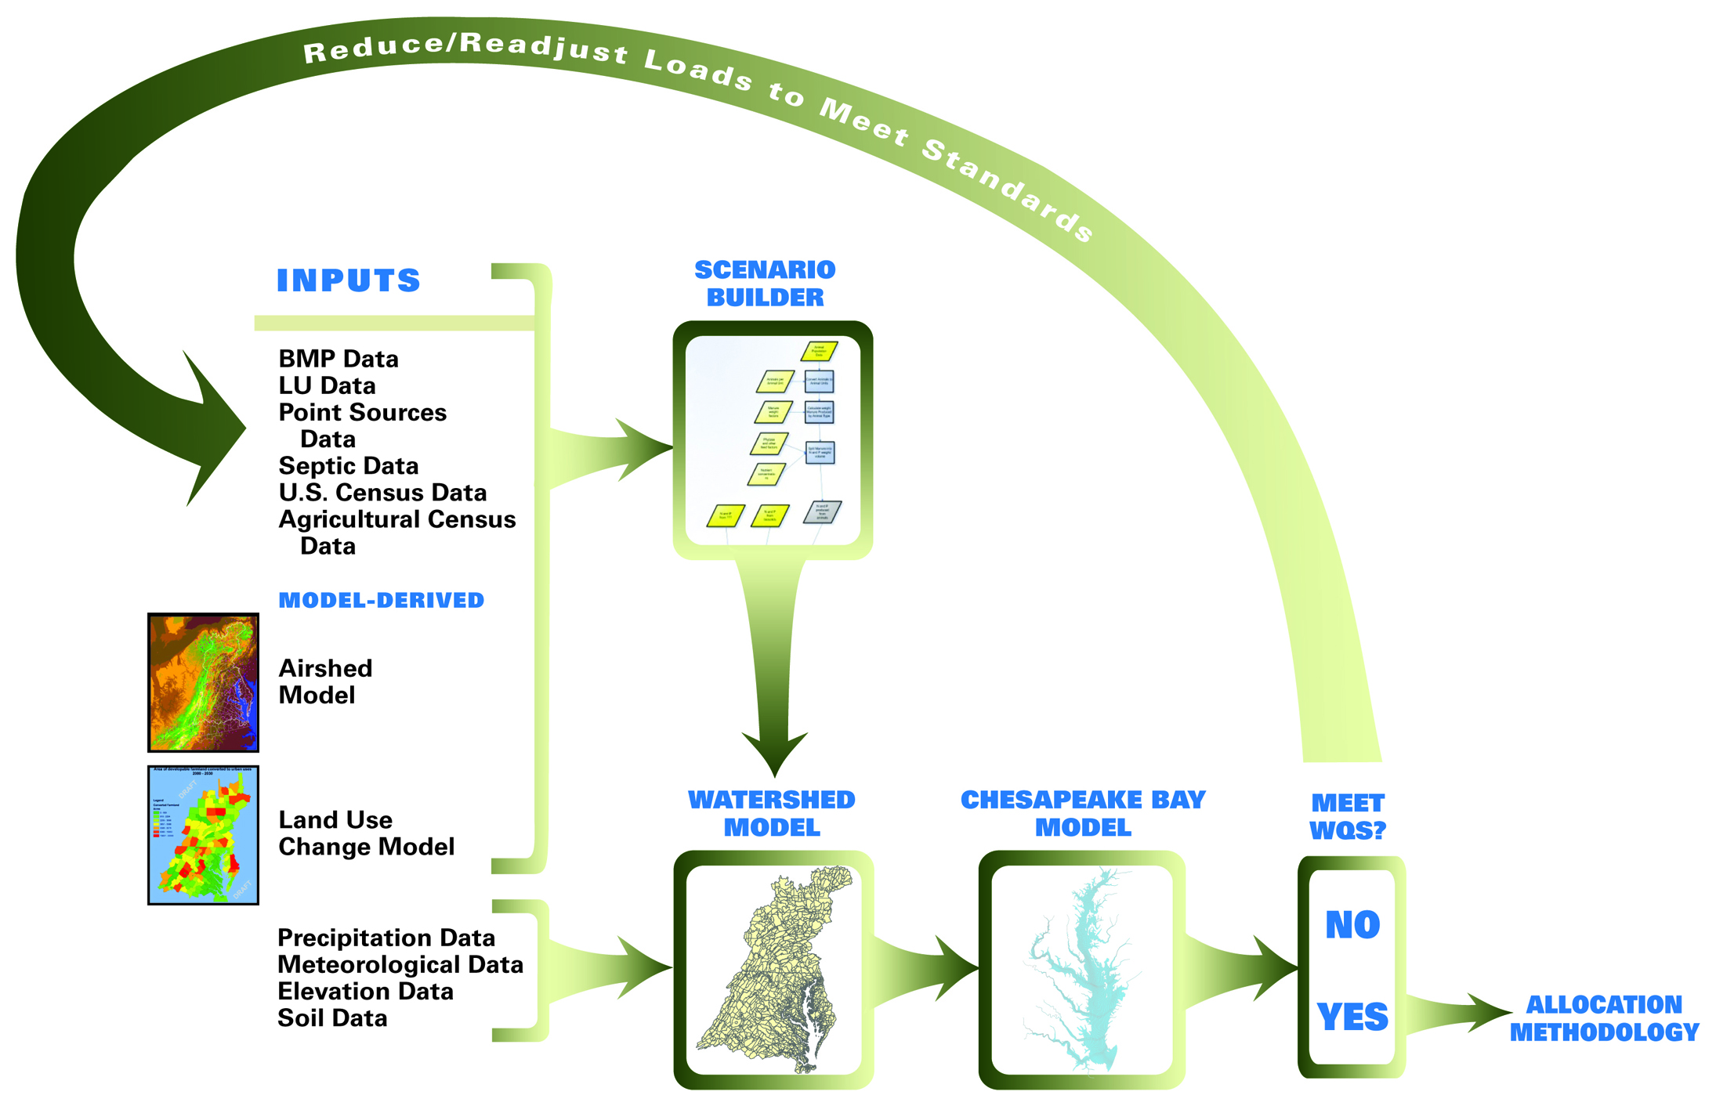
Chesapeake Bay Partnership Modeling Tools
Notes:
This is the updated slide of modeling tools to replace your slide #6 titled “CB paternship modeling tools.”

Slide 9
Each segment consists of separately-modeled land uses:
Pervious Urban
Impervious Urban
  Regulated and non-regulated versions of the above
Construction
Extractive
  Combined Sewer System versions of the above
Forest/Wooded/Open
Harvested Forest
Agriculture
Row crops (high till)
Row crops (low till)
Vegetable Crops
Pasture
Fertilized Hay
Alfalfa
Nutrient management versions of the above
Nursery
Degraded Riparian Pasture
AFO/CAFO
Unfertilized Hay
4

Slide 10
Non-Point Source Practices and Programs
Nutrient Management Applications
Fertilizer
Atmosphere
Manure
Runoff
28

Slide 11
Non-Point Source Practices and Programs
Practices that Alter Nutrient Applications to Agriculture Land
Phytase
Precision Feeding/Forage Management Manure Transport

Slide 12
Non-Point Source Practices and Programs
Practices With Nutrient and Sediment Reduction Efficiencies
Fertilizer
Atmosphere
Manure
Runoff

Slide 13

Non-Point Source Practices and Programs
Practices With Nutrient and Sediment Reduction Efficiencies
Load reductions attributed to upland benefit employing “efficiencies”
  Efficiencies can vary by hydro-geomorphic region
Fertilizer
Atmosphere
Manure
Runoff

Slide 14
Current Agricultural BMP List in Model
Nutrient Management
Nutrient Management
Precision Agriculture
Enhanced Nutrient Management
Conservation Tillage
Continuous No-Till
Conservation Tillage
Cover Crops
Cover Crops – Late Planting
Cover Crops – Early Planting
Small Grain Enhancement – Late Planting
Small Grain Enhancement – Early Planting
Pasture Grazing BMPs
Alternative Watering Facilities
Stream Access Control with Fencing
Prescribed Grazing
Precision Intensive Rotational Grazing
Horse Pasture Management
Other Agricultural BMPS
Forest Buffers
Wetland Restoration
Land Retirement
Grass Buffers
Forest Buffers
Tree Planting
Carbon Sequestration/Alternative Crops
Conservation Plans/SCWQP
Animal Waste Management Systems
Mortality Composters
Water Control Structures
Non-Urban Stream Restoration
Poultry Phytase
Poultry Litter Management
Dairy Precision Feeding and Forage
Management
Swine Phytase
Ammonia Emissions Reductions
Notes:
Refined title.
Checking to make sure this is the current list.

Slide 15
Chesapeake Bay Program Watershed Model Urban/Suburban BMPs – Current List
Other Urban/Suburban BMP
Forest Conservation
Impervious Surface and Urban Growth Reduction
Forest Buffers (Urban)
Tree Planting (Urban)
Grass Buffers (Urban)
Stream Restoration (Urban)
Erosion and Sediment Control
Nutrient Management (Urban)
Street Sweeping
Forest Buffers (Mixed Open)
Wetland Restoration (Mixed Open)
Tree Planting (Mixed Open)
Nutrient Management (Mixed Open)
Abandoned Mine Reclamation
Non-Urban Stream Restoration (Mixed Open)
Dirt and Gravel Road Erosion
and Sediment Control (Mixed Open)
Stormwater Management
Wet Ponds and Wetlands
Dry Detention Ponds and
Hydrodynamic Structures
Dry Extended Detention Ponds
Urban Infiltration Practices
Urban Filtering Practices
Recent/Retrofit Stormwater Management
Septic BMPs
Septic Connections
Septic Denitrification
Septic Pumping
Notes:
Refined title.

Slide 16
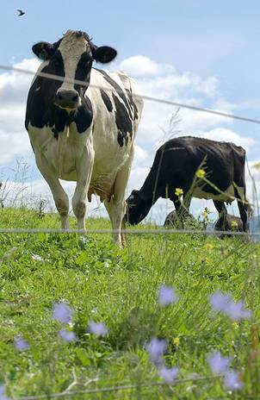
Interim Chesapeake Bay Program
Agricultural BMPs – To Add to Model
Nutrient Management
Irrigation Management
Passive Hay Management
Manure Management
Liquid Manure Injection
Poultry Litter Injection
Manure Processing Technology
Poultry Litter Amendments
Mortality Management
Mortality Incineration
Soil Amendments
Phosphorus Absorbing Materials
Nursery Management
Nursery Runoff Management
Non-Cost Shared Practices
Tracking and Reporting
Notes:
Checking to make sure this is the current list.
May suggest combining with next slide.

Slide 17
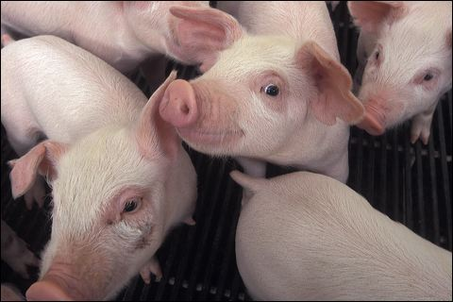
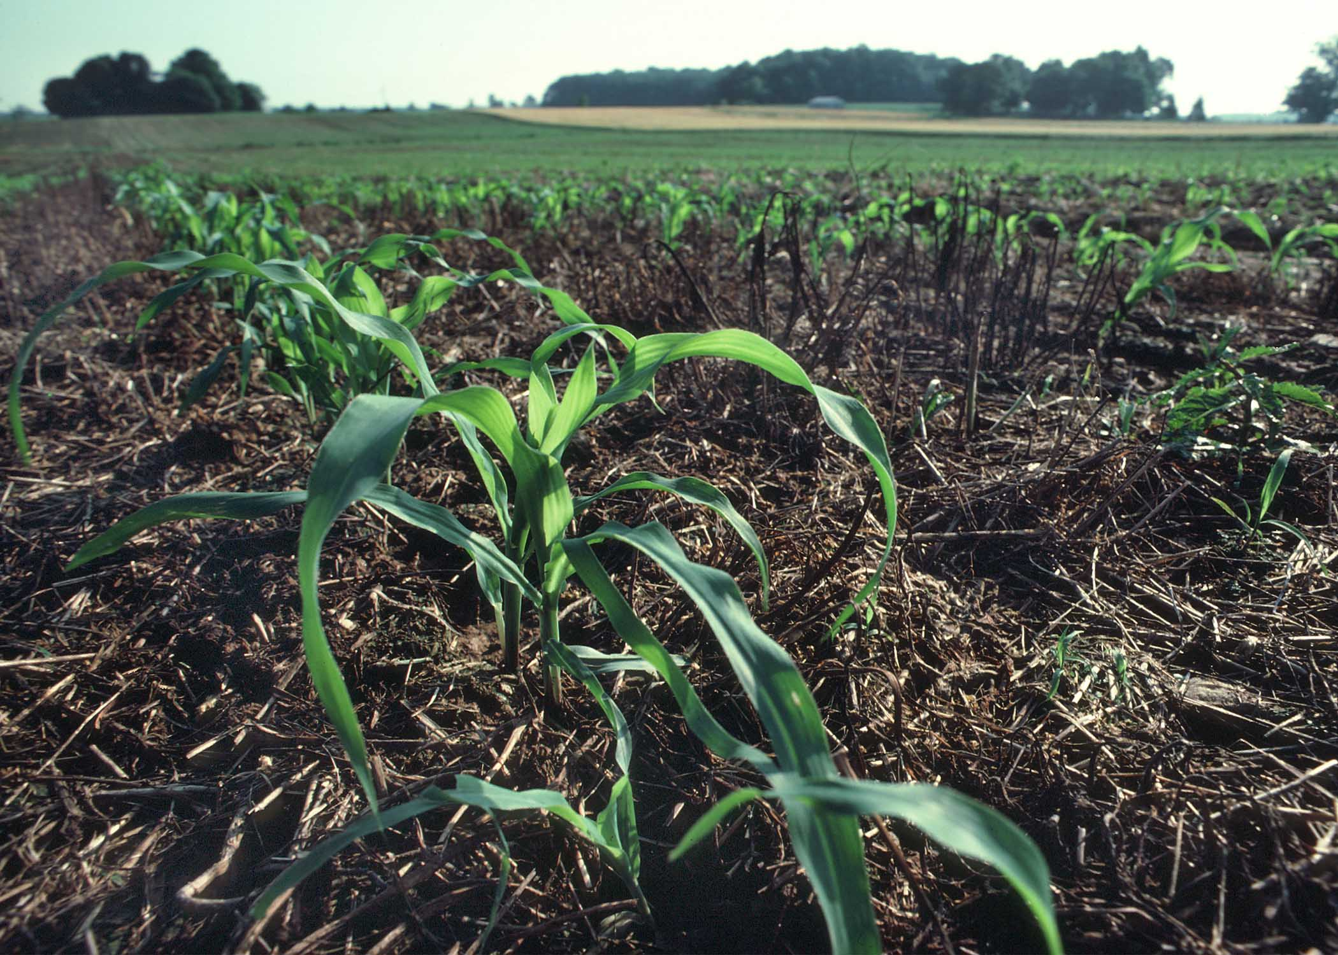
Proposed Chesapeake Bay Program Agricultural BMPs
Manure Management
Heavy Use Area Poultry Pads
Poultry Litter Management
Stormwater Management
Agricultural Stormwater Management
Sinkhole Management
Sink-Hole Grass Buffers
Notes:
Checking to ensure current list.
May suggest combining with previous slide.

Slide 18
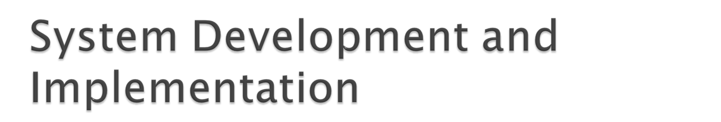
Development Decisions:
What to collect
Where to collect
Protocol (how) to collect
Existing System Update or Design a New System?
Training on System Selected
Pilot System
Reliability/Validity Testing
Adjust System/Training
Communication Strategy
Implementation
Reliability/Validity Testing
Future Year Systems?
Success Considerations:
Cost of system selected
Technical Assistance requirements
People or Technology Intensive
Sustainability of System for Future Year Collections
Landowner Acceptance
State Agency Acceptance
EPA Acceptance
Public Acceptance
Culture Change Requirements

Slide 19
System | Method | Sample Size | Verification
1. Farm by Farm Inventory | Farm visit by trained personnel | 100% | Through on-site visit by trained personnel while collecting data
2. Farmer Self Certification with Onsite visit | Farmer fills out survey and trained personnel visit site to confirm | 100% (Return rate by the farmer affects %) | Through on-site visit by trained personnel
3. Farmer Self Certifications | Farmer fills out survey and mails back | 100% (Return rate by the farmer affects % completed in sample) | By Farmer self certification when submitted
4. Use of Existing federal, state or District records | Trained personnel review existing farm data on practice implementation | <100%(Depends on the completeness of the records in the office) | Trained personnel verify through knowledge of the farm or through calls made to the farmer
5. Transect of County or Watersheds | Transect completed by trained personnel in selected areas of County or Watershed | Statistically Determined | Verified by the trained personnel completing the transect on the ground
6. Farmer Reported at USDA office | Farmers go to USDA office and reports practices (similar to FSA crop reporting) | 100% (Rate will be affected by farmers who do not respond) | Farmer certified during the visit at USDA office
7. NASS Survey | NASS survey mailed to farm community. | NASS determined %. Return rate will affect outcome | NASS certification procedures
8. Aerial Photography Remote Sensing | Remote Sensing determination of practice implementation | 100% or other statistically selected amount | Verification usually involves determining photographic signatures by field checks to determine accuracy of office determination
9. NRI Point or some other statistically selected sites | Remote Sensing or Field Visit to the points. | 100% of Points selected completed | Verification can be same as Aerial Remote Sensing method or by visit to each site to collect and certify data

Slide 20
What Systems Are States Currently Using for Data Collection?
Maryland- Conservation Tracker
Virginia-Agricultural BMP Tracking Program
Pennsylvania- Transect Trials- Penn State Model
West Virginia-Farm by Farm Inventory
New York-Agricultural Environmental Management Program (AEM)
Delaware-NRCS ToolKit-Special Trials
Notes:
Fixed typo in title (added “s” to state).

Slide 21

Has completed first once over of state using existing records, knowledge of farms and recorded information in Conservation Tracker.
Currently piloting farm by farm evaluation, searching for non-cost shared practices in Upper Chester watershed. Developing a data collection/verification sheet and trial definitions for functionally equivalent practices.
Using computerized nutrient trading tool to evaluate farm progress toward meeting TMDL goals
Noting functional equivalent practices in pilot.
Willing to share system and training materials with other states.

Slide 22
Using system developed in 2010 called Agricultural BMP Tracking Program for a computerized farm inventory of conservation practices in the State cost share and tax credit programs. Contains an accounting system for tracking dollars committed and spent. Maintained by District field office staff.
Districts develop plans (RMA-Resource Mgt. Area or RPA-Resource Protection Area) that have different buffer strip requirements, noting what additional needs to be done to meet state or NRCS Standards and Specifications.
Completed a report to the Secretary of Natural Resources in November 2010 for “Development of a Strategy to Collect Data Pertaining to the Voluntary Agriculture and Forestry BMPs”. Three Phase Implementation:
  Phase 1-Pilot in 6 Districts to collect and report data. Draft protocols will be developed for collection, spot checking, data entry and other guidance. Adjust current Tracker to collect voluntary practice data.
  Phase 2- Pending funding, the focus of data collection will be for practices to help meet the requirements of TMDL.
  Phase 3- Explore collection of functionally equivalent practices and getting approval to enter them into the Bay Model.

Slide 23

Three Previous Trials:
  Bradford County Farm Visits to 20% of farms. Took one year to complete. Used some aerial photography and did direct mailing to some Municipalities (95% response rate).
  Lancaster County BMP Transect using CTIC methodology. Looked at Core 4 practices with 11 technicians. Covered approximately 20% of farms in county. Direct mailings also.
  RC&D Tillage Survey: in 7 counties using CTIC methodology. Determined residue amounts in the fields at each stop.
Working with Penn State to develop a farmer friendly nutrient evaluation tool or a one stop conservation plan. Farmer would identify farm and delineate fields and indicate nutrient application into a nutrient balance sheet. System calculates if farmer meets the requirements (red or green) and farmer adjust rates until acceptable. Plan to add a RUSLE soil loss calculation. If TA dollars are available they would send to Districts to verify or do farmer self certification.

Slide 24
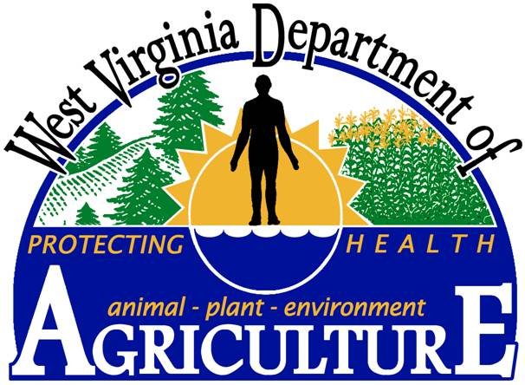
West Virginia
Farm by farm inventory
  100 percent of farms by farm visit
Plans to collect all Non-cost shared, Voluntary Best Management Practices
Would verify through on-site visit by trained personnel while collecting data

Slide 25


  NY State reports BMPs implementation to the EPA through the Upper Susquehanna Coalition (USC) of 16 Soil and Water Conservation Districts in NY
  The process for collecting farmer initiated BMPs starts with the state funded Agricultural Environmental Management (AEM) program
  AEM is the “umbrella program” that provides a consistent format to efficiently identify environmental concerns and opportunities through a comprehensive on-farm assessment
  AEM is a progressive planning process where district staff use worksheets to take the farmer through a five-tiered process that includes inventory, assessment, plan development, implementation and evaluation that documents the farmers environmental issues and takes into account the farmers resources and timelines
  This approach has been in place for over a decade and has strong Ag community support. Data collection is performed or verified by trained Ag technicians during individual farm visits
  The USC’s goal is to collect data on as many conservation practices as possible whether the practice was cost-shared or paid exclusively by the farmer
  The USC is collecting data on non-cost shared practices even if they fail to meet EPA or NRCS standards but have functional equivalency
  The scope and depth of USC partnerships has created strong relationships with key agencies to help the USC provide reliable, consistent data with a network to communicate strategy and outcomes

Slide 26
Utilizing NRCS Toolkit to collect federal, state and 319 cost-shared practices. Also have a state voluntary nutrient management reporting requirement. Tracking manure transport. There are some NGO practices applied in the state.
Current pilots:
  Working with Poultry Companies to compile information on voluntary and non-cost shared practices using a check sheet by Flock supervisors.
  FSA collected data last fall on cover crops when farmers came in to report to get a better handle of actual acreage. Asked if it was a cover crop or commodity crop.
  Dept of Ag. State Statistician working on survey of voluntary installation of non-cost shared irrigation systems being installed
Interested in collecting functionally equivalent practices (primarily buffers). Have not developed a system to collect voluntary practices.

Slide 27
Other Options to Explore:
FSA Data Collection
NASS Data Collection
Geo Agro Conservation Plug-In
World Resource Institute NutrientNet
NRI Conservation Tillage and Nutrient Management Survey
USGS Data Sharing Project (NRCS/FSA Data Transfer)
Conservation Delivery Streamlining Initiative (NRCS)

Slide 28

States are unified in their desire to collect data on as many practices on the ground as possible.
All wish to do a farm by farm inventory by trained professionals.
All realize this is expensive but gives the best possible results with strong Ag community support.
Money, people and priorities are major issues.

Slide 29

Some states want to collect information on everything (all non-cost shared, meeting NRCS standards or Functional Equivalents).
Others want to evaluate the return (in Bay Model credits) for the investment (personnel and system costs) before jumping into action.
Notes:
Fixed typo in first bullet (missing “s” in states).

Slide 30

Because there is wide variance in federal and state cost share programs between states there must be a method for collecting any and all practices whether cost shared or not.
Example: Cover Crops are cost shared in one state, but not other states. Some receive federal and state funding (double counting issue). Even federal EQIP practices may not be the same from state to state.

Slide 31
Legal issues surrounding collection of voluntary practices.
FOIA for state collected data.
Permission from landowners to collect information.
Requirement for maintenance of practices.
Creating landowner ineligibility for future cost-sharing.
Data Issues:
  Defining “functionally equivalent practices”, determining how to credit “almost functional equivalent” practices.
  Data collection and verification protocol acceptance by CBP partnership.
  Acceptance of practices and assignment of efficiencies by Ag Working Group and CBP partnership.
  Double counting on jointly funded practices.
Notes:
Changed “acceptance by EPA” to acceptance by CBP partnership. This gets at our idea of wanting full sign off by ag and env. Secretaries on the Principals’ Staff Committee of the CBP.
Added bullet 1 to “data issues” to indicate that we need to have CBP agreement on how we are going to go about defining “functionally equivalent” practices (those practices that are functioning as a practice that was designed according to NRCS practice standard) and “sub-standard” practices (those practices that fall short of meeting the NRCS practice standard and likely are functioning at a lower level).

Slide 32
Need a “Plan B” – Back up plan in case Plan A cannot be implemented.
    For example, if funding is insufficient for on-farm assessments, what is back-up plan for tracking and verifying non-cost share practices?
Notes:
Need to mention need for “Plan B”

Slide 33
EPA Supports this Effort
EPA fully supports crediting verified non-cost share practices in the CBP Watershed Model.
NACD has been providing EPA with regular updates.
NACD and EPA will be meeting with each state to further discuss state ideas and approaches.
EPA goal is to have “no surprise” approach so that everyone knows what data and verification protocols are necessary for data to be counted.
EPA has created a new grant program “CBRAP” that provides an additional $11.2 million which can be used to support these data tracking and verification efforts.
Notes:
Added this slide.

Slide 34
Next Steps
Finalize data tracking and verification protocols with USDA, EPA, NACD and States. Summer 2011.
    Protocols would include “Plan B” (back-up plan) in event that Plan A can’t be implemented.
Continue Briefings to Chesapeake Bay Program – Summer/Fall 2011
    Workgroup NACD has briefed Agriculture Workgroup twice and will continue to provide regular updates.
    Agriculture Workgroup will prioritize developing effectiveness estimates for any non-cost share practices not meeting NRCS standards.
Test protocols.
E.O. Strategy date for implementing protocols is July 2012.

Slide 35
Land adequately and properly treated from a resource protection perspective.
Land that meets the TMDL goal for each acre, field, farm in the watershed.
Verify all Conservation Practices, BMP’s on the ground, managed and maintained properly.
Viable, vibrant and competitive agricultural production for agricultural producers in the Chesapeake Bay.

Slide 36
Voluntary installed by Farmer
DATA, DATA EVERYWHERE!
Forest Service or State Forest Agencies
USGS: NRCS and FSA data
States
MD: Cons Tracker
VA: BMP Tracker
PA : Penn State
DE: Toolkit
WV: Farm by Farm
NY: AEM
NRCS: CDSI, Plug In, Toolkit, Protracts
EPA funded 319 Practices
Easements Databases: States, NRCS, NGO’s; USFWS- Partners for Wildlife; AFT
Environmental Markets: Registries; World Resources Institute; Etc.
Fed, State, local Cost Share

Slide 37

Bob Ensor, Project Leader,410-489-7987, Howard SCD;
rensor@howardcountymd.gov
Dana York, Green Earth Connection; 410-708-6794, dyork818@yahoo.com

