Slide 1



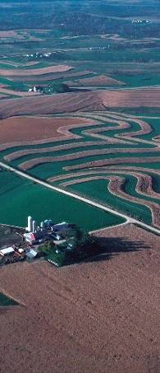
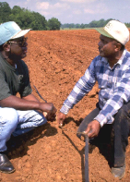

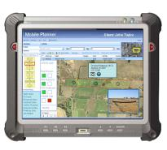
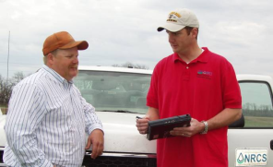
Conservation Delivery Streamlining Initiative
OVERVIEW:
INITIATIVES & STRATEGIES
January 2011
http://www.nrcs.usda.gov/about/CDSI/index.html
https://nrcs.sc.egov.usda.gov/spa/streamline

Slide 2

Conservation Delivery Streamlining Initiative
BACKGROUND
Concerns over the clerical burden on the field office technical staff from the expanded FA roles.
Lack of time in field planning with customers (20-40%?).
CASPeR effort (2007) described
opportunities for a new model.
IT tools complex, time consuming,
not integrated.
Stove-piped processes, policies,
data and tools.
Potential loss of technical expertise.
https://nrcs.sc.egov.usda.gov/spa/streamline

Slide 3
Conservation Delivery Streamlining Initiative
PURPOSE AND OBJECTIVES
In early 2009, NRCS initiated an Agency-wide effort to define and implement a sustainable business model for delivering conservation assistance that will:
Simplify Conservation Delivery – Easier for customers and employees.
Streamline Business Processes – Increased efficiency and integrated across business lines.
Ensure Science-based Assistance - Continued delivery of technically-sound products and services.
https://nrcs.sc.egov.usda.gov/spa/streamline

Slide 4
Conservation Delivery Streamlining Initiative
PURPOSE AND OBJECTIVES (continued)
Examples of success criteria:
Field staff will spend as much as 75% of their time in the field.
Clearly defined business processes used in decision-making.
Over 80% of FA clerical time eliminated, automated, or reassigned.
Tools guide employees through conservation assistance steps.
Tools and data are accessible to staff when and where needed.
The “admin” time from application to funding is 2 weeks or less.
Resource concerns document all TA service and FA obligations.
FA business processes are standardized nationwide.
https://nrcs.sc.egov.usda.gov/spa/streamline

Slide 5
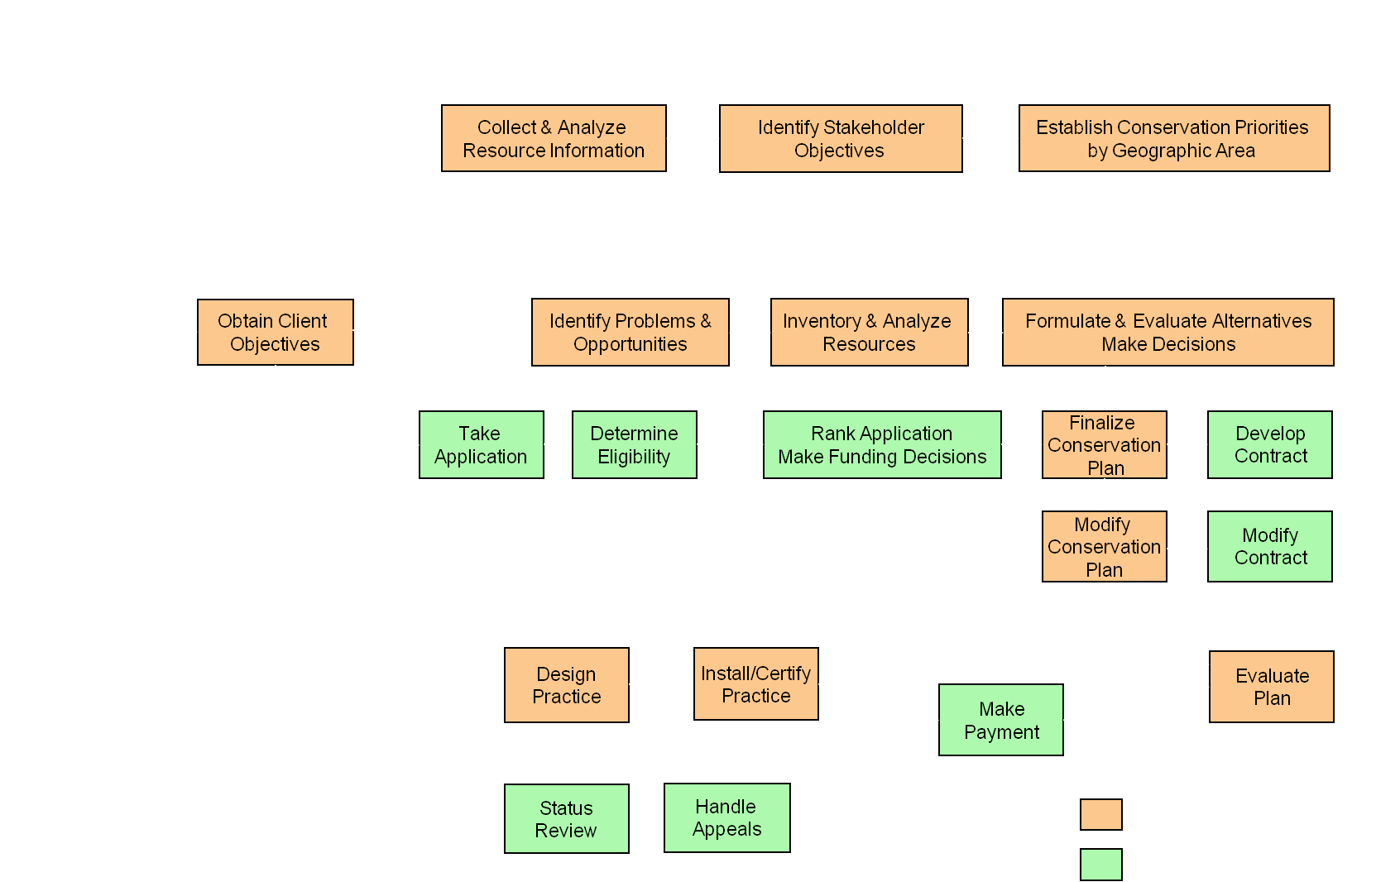
Conservation Delivery Streamlining Initiative
INITIATIVE 1. Define, streamline, and integrate formalized conservation assistance processes across Agency business lines.
Strategy 1.1 Clearly defined business process models that span organizational areas will be formalized for all programs and activities.

Slide 6
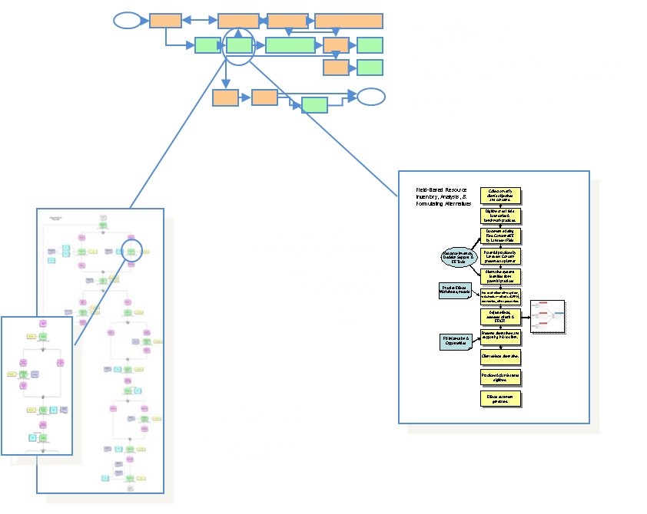
Conservation Delivery Streamlining Initiative
INITIATIVE 1 - Continued
Strategy 1.2 Institutionalize
business process models Agency-wide across policy & program development, directives, training, & IT applications design.
Strategy 1.3 Integrate business activity monitoring into business & IT systems.

Slide 7

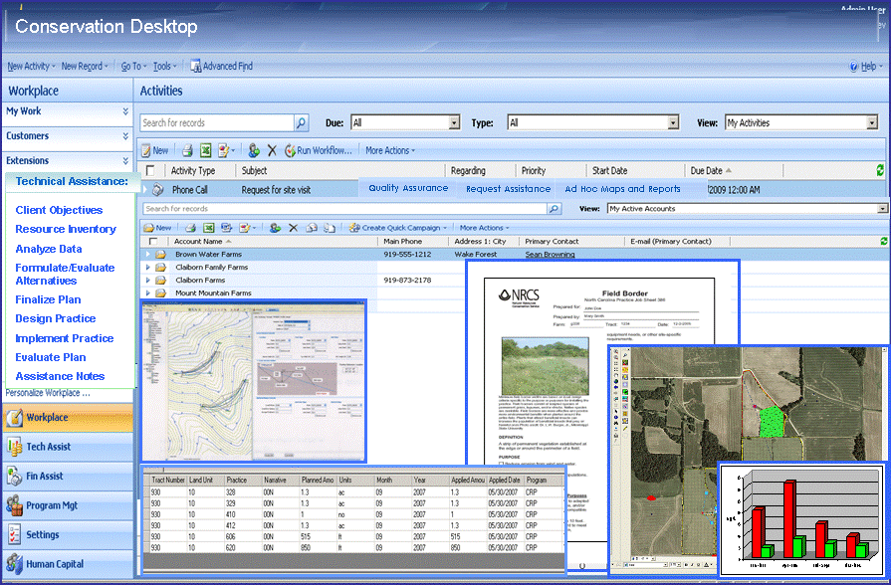
Conservation Delivery Streamlining Initiative
INITIATIVE 2. Prioritize and deploy information technology that effectively supports and aligns with the delivery of conservation assistance.
Strategy 2.1 Geospatial data and services will be fully integrated into NRCS’ business processes, IT systems and tools.
Strategy 2.2 A Conservation Desktop concept will be implemented nationwide to serve as a single portal for staff to manage workflow and access data and tools.

Slide 8
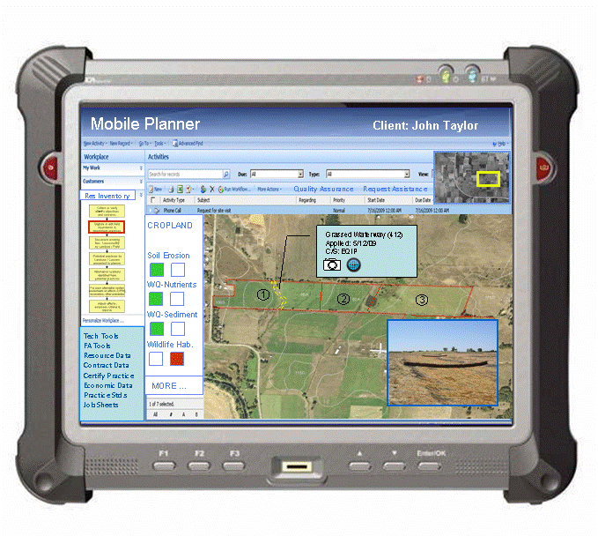
Conservation Delivery Streamlining Initiative
INITIATIVE 2 - Continued
Strategy 2.3 The use of mobile computing will be institutionalized for conducting the resource inventory, analysis, and decision support steps of planning, as well as other selected field-based processes.

Slide 9
Conservation Delivery Streamlining Initiative
INITIATIVE 2 - Continued
Strategy 2.4 NRCS’ resource inventory, decision support, & design tools used by field staff will be restructured to align with conservation assistance processes.
Strategy 2.5 Implement an enterprise architecture that facilitates the sharing of services and data.
Strategy 2.6 Develop a formal strategy for encouraging, guiding, documenting, & sharing business process and IT innovations from the state, area, and field levels.

Slide 10
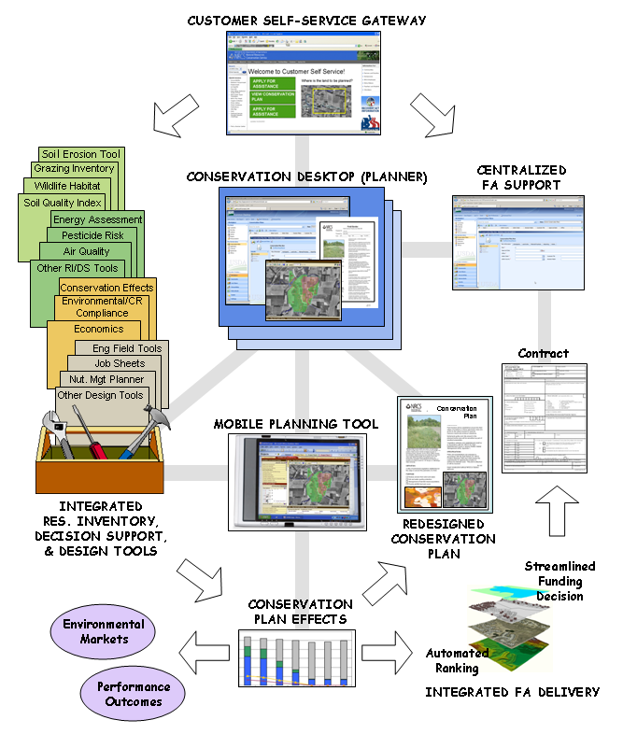
Conservation Delivery Streamlining Initiative
BUSINESS
SYSTEMS PERSPECTIVE

Slide 11
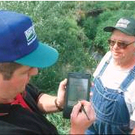
Conservation Delivery Streamlining Initiative
INITIATIVE 3. Provide field technical staff with natural resource science and technology focused to support conservation planning and application.
Strategy 3.1 Establish Resource Concerns and Planning Criteria that are clear, repeatable, scalable, & science-based.
Strategy 3.2 Integrate area-wide assessments in the conservation assistance business process.
Strategy 3.3 Conservation effects will be integrated into NRCS planning tools.

Slide 12
Conservation Delivery Streamlining Initiative
INITIATIVE 4. Implement programs through alternative staffing and delivery approaches designed around efficient business processes.
Strategy 4.1 Establish a more centralized FA clerical support structure and supporting information system to minimize non-technical workload on field staff.
Strategy 4.2 Evaluate and implement alternative business processes that streamline FA delivery.

Slide 13


Conservation Delivery Streamlining Initiative
INITIATIVE 5. Establish tools and processes for interacting with clients that are resource-centric, enhance customer service, and increase efficiency.
Strategy 5.1 Implement a Client Service Gateway concept that utilizes a variety of technologies and approaches.
Strategy 5.2 Redesign NRCS’ Conservation Assistance product line to more effectively communicate NRCS’ critical information.

Slide 14
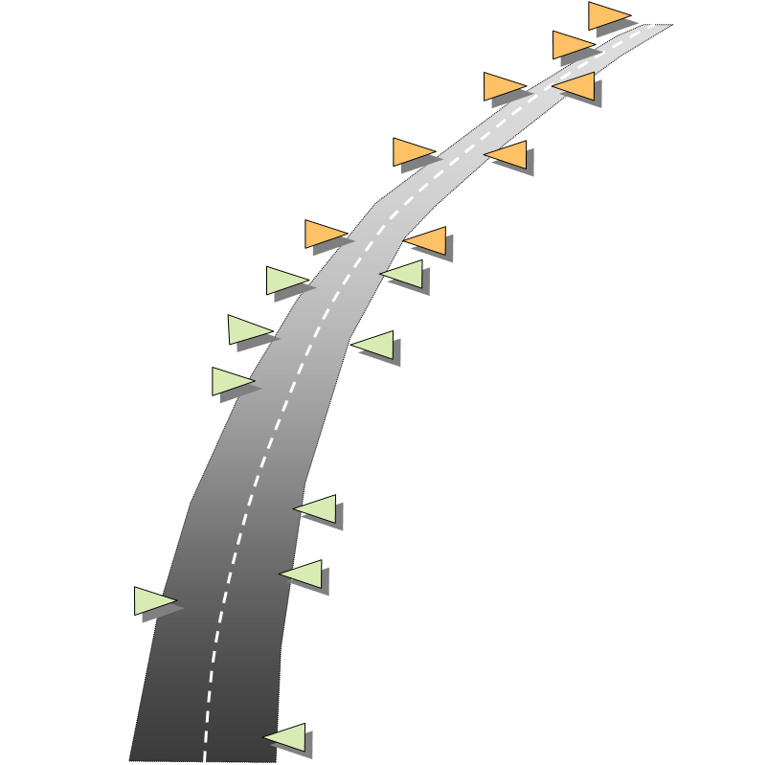
STREAMLINING
INITIATIVE ROADMAP

