Slide 1
SO- You Have a Protocol- What’s NEXT?
Bob Ensor and Dana York

Slide 2
What Does it Take to Implement the Selected System?
Accuracy of the collected data is dependent on how well the system was designed, tested and implemented.
Many steps need to be completed before the first piece of data is collected.
The time spent on these upfront actions can increase the accuracy of the data by 50%. Lack of taking these actions can make the data incorrect or unusable.

Slide 3
There are Many Decisions to Make in the Implementation of a Successful Data Collection System
Success Considerations:
Cost of system selected
Technical Assistance requirements
People or Technology Intensive
Sustainability of System for Future Year Collections
Landowner Acceptance
State Agency Acceptance
EPA Acceptance
Public Acceptance
Culture Change Requirements
Development Decisions:
What to collect
Where to collect
Protocol (how) to collect
Existing System Update or Design a
New System?
Training on System Selected
Pilot System
Reliability/Validity Testing
Adjust System/Training
Communication Strategy
Implementation
Reliability/Validity Testing
Future Year Systems?

Slide 4
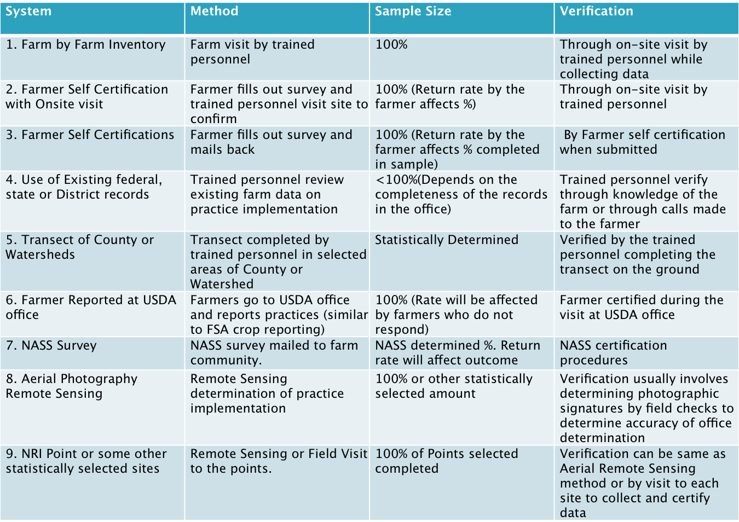
Determining How to Collect the Data is One of the First Critical Decisions

Slide 5
Do Not Roll out an Un-Tested System.
Once you have designed your system there are several things you should consider:
Ease of use by the data entry individual-is it hard to make changes to data; can you get reports from the system to see what has been entered by whom; in future years who will be able to correct , change, or delete data; etc.
System issues-how will you train on data entry; how many people can be on the system at one time; does it connect directly to NEIEN; is the data secure and who has access to data; etc.

Slide 6
Training of the Data Collectors Can Make or Break You
Individuals who collect the data must all similarly understand what they are collecting. This includes the development of definitions that are easily understood and reported the same way each time that situation is found. This is called Reliability.
Reliability is assured by having good documentation, training sessions and trial tests that are then reviewed to see that each collector is seeing and recording the same thing.
Trial tests may have to be completed several times, changing the training and documentation each time, until the information provided is adequate for the process used.

Slide 7
Certification of the Data Collectors Can Increase Reliability of the Data Collected
Many times a certification process can be developed to certify the data collectors and data entry individuals.
A certification process includes: training, multiple collections against a known standard; collection with oversight or observation; and independent collection with verification.
Once an individual is certified, there are usually refresher course requirements or training when there are changes to what or how the data is collected.

Slide 8
Pilot Tests Save You Time and Frustration by Users
Pilots are important to conduct to: test the training and documentation that has been provided; to get a better estimate of cost and how long the project will take; and to determine if the data collected process is on target for what you intended to collect.
Pilots also work out the “kink’s”. It is far better to change everything in a pilot so the system runs smoothly, than to not test and create frustration or a “bad” experience for collectors, and then have to re-enter the same data in a changed system.

Slide 9
Data Validity Testing makes Data Credible
Validity is when you compare data you collected to data from another system of collection to see if you have the same or similar answers.
Validity checks of the data add credibility to the effort and the system you selected to use.
It can also be used to check to see if someone is “gaming” the system.

Slide 10
Take Time to Develop and Implement a Good Communication Strategy
Communication Strategies help to alleviate concern.
You will need three strategies: one for those from whom you are gathering information; one for those who are collecting the data; one for the general public about the overall activity.
Do not over-promise what you will provide to any of these groups.
Make sure there is a final report of the outcomes from the effort.
Communicate often throughout the process: both how is going-- to what did you find out.

Slide 11
Data Verification will Support the Upfront Actions in Implementation of Your System
Data Verification is required to give credibility to the effort.
The first data verification process is tested during the pilot to determine if the system selected is getting the data you wanted.
After the system has been tested, data verification is used to test the accuracy of the data collectors. If they have gone through a certification process, usually less verification is needed. However, a 5-20% check of the collected data or of each collector is reasonable.
Make sure that you make corrections immediately when errors are found to keep data re-entry to the minimum.

Slide 12
Field Verification of Conservation Practices for Bay Model (Example)
All practices are OK as reported, meeting standards and specifications, reducing nutrients and sediment as intended.
No remedial action required, verify in report to responsible state agency.

Slide 13
Field Verification of Conservation Practices for Bay Model
Note remedial actions required in report to state agency
C/S involved? Is it still a functional equivalent?
Should it?
Inform landowner, give time to repair, remove from, or change status in reporting system until fix is completed.
Practice is there, but does not meet standard and specifications.
Or is it a functional equivalent?
Note status in report to state agency
Inform landowner, note additional work needed to meet standards and specs or functional equivalent status.
Or is it “almost” functional equivalent?

Slide 14
Field Verification of Conservation Practices for Bay Model
Inform landowner, remove practice from the reporting system.
Unintentional: weather related failure, wildlife damage, etc.
Practice not there… Uh Oh!
Inform Landowner, remove practice from system. Bar from participating in C/S Programs for one year, spot check all practices on land controlled by farmer for one year.
Intentional: No obvious attempt to comply, potential fraud

Slide 15
Future Years Of Data Collection Can Use Different Systems
You will need to decide what will you do in future years to collect additional data or to make changes to the data.
You can go to a less intensive system if you do an intensive baseline survey.
You should have a good idea of what you will do in future years before you do the first data collection-so you can inform landowners what to expect in the future.

Slide 16
“Certainty”
Certainty is a topic that has been in discussion with USDA/EPA and States. At this time States want to develop this concept specific to their state. Virginia has already passed a proposed regulation for this concept.
Options are wide open at this moment,
Most expect-- If farmer meets TMDL & continues then:
Less intense checking for several years (3 – 5?)
Farmer must continue to meet TMDL,
Farmer is assured no change of the requirements or expectations from what was originally agreed.

Slide 17
The Big Job Continues...
This is a big job. Selection of the protocol that the state will use is just the beginning off the implementation process.
This data collection protocol is an opportunity for those who are interested to see farmers get full credit for their conservation efforts.

Slide 18
Questions?
Bob Ensor, 410-489-7987, Project Leader, rensor@howardcountymd.gov
Dana York, 410-708-6794, dyork818@yahoo.com

